Slide 1
person authentication using keystroke dynamics
NAME : HARSHIKA T
MCA S4-A
ROLL NO : 57

Slide 2
RELEVANCE OF TOPIC
Authentication systems like passwords, patterns, biometrics, etc. are used. But these systems have some drawbacks.
Biometric system is more secure than password and pattern. But it is more threatening to the user physically.
Hence there is a need to generate foolproof measures to prevent such unauthorized access
One such preventive method to give access to individuals by detecting their unique behavioral patterns is an individual’s typing rhythm.
This unique typing rhythm tends to become a natural choice for the security of computers and is commonly known as Keystroke Dynamics

Slide 3
Description of the project
Keystroke dynamics is study of whether people can be distinguished by their typing rhythm.
Keystroke dynamics is a behavioural biometric.
The unique typing patterns of users can be used as a signature to identify genuine users from imposters.
Economical to implement and can be easily integrated into the existing computer security systems.

Slide 4
Working of the model
This model is used to secure the password of the user. A user can only access his or her account because of the unique typing way of each. In this system the model collect the method of typing and speed by providing phrase to the user by typing it . The way of typing time and speed are understand from it and stored. Then in login time other than username and password we should also type the phrase. If this matches then the model will give the access. Through this model we can avoid the un authenticated access .It provide more security.
APPLICATIONS:-
Online exams
Banking sector
Online forum

Slide 5
OBJECTIVES OF THE PROJECT
To ensure security to the users for the passwords by behavioral biometric.
To distinguish people by their typing rhythm
To ensure correct identification and verification of respective user.

Slide 6
EXISTING SYSTEM
The Existing system finds the Person’s identification by using a biometric or another authentication method. The user enters the credentials, later an otp is generated.
Passwords can be guessed easily if it is not strong enough.
Another method is biometrics like fingerprints etc. but sometimes these identification method makes problems for the users. This provides less security to users.
In this, anyone can access it by using their username and password.
The existing system isn’t secure enough.

Slide 7
PROPOSED SYSTEM
The proposed model records the unique typing style and pattern of a user at the time when they register into the system by feature extraction and trains the knowledge base with these feature data. Then, identify and authenticate the users at a large stage when they try to log into the system or access the system in any way. The model provides advanced-level security to critical systems where security is one of the major concerns. The model does not require any extra hardware like other physiological biometric systems do and hence, the overall cost is considerably
negligible.

Slide 8
INPUT/OUTPUT AND MODULES identified
INPUT:-
Users typing pattern
OUTPUT:-
Access given if the typing time and speed matches
MODULES:-
Registration phase
Feature extraction
Verification phase
FRONTEND:-HTML, CSS,JavaScript
BACKEND:-PYTHON,MYSQL

Slide 9
METHODOLOGY
It consist of many phases like registration, verification, analysing etc. Here the dataset is extracted at the registration time. The input is given by the user and it is collected and stored in the database.
Various standard machine learning algorithms are used to keystroke identification. Among the selected algorithms, the Decision Tree provided the best accuracy. Decision tree is the most powerful and popular tool for classification and prediction.
A Decision tree is a flowchart like tree structure, where each internal node denotes a test on an attribute, each branch represents an outcome of the test, and each leaf node holds a class label. Decision trees classify instances by sorting them down the tree from the root to some leaf node

Slide 10
The Decision Tree working can be explained on the basis of the below algorithm:
Step-1: Begin the tree with the root node, says S, which contains the complete dataset.
Step-2: Find the best attribute in the dataset using Attribute Selection Measure (ASM).
Step-3: Divide the S into subsets that contains possible values for the best attributes.
Step-4: Generate the decision tree node, which contains the best attribute.
Step-5: Recursively make new decision trees using the subsets of the dataset created in step -3. Continue this process until a stage is reached where you cannot further classify the nodes and called the final node as a leaf node.

Slide 11


Slide 12
FEATURE OF decision tree
Decision trees are able to generate understandable rules.
Decision trees perform classification without requiring much computation.
Decision trees are able to handle both continuous and categorical variables.
Decision trees provide a clear indication of which fields are most important for prediction or classification.
In this project, decision tree is used to train the data. The keystroke values obtained at the time of registration is converted into pickle value. The input value is checked with the trained value

Slide 13
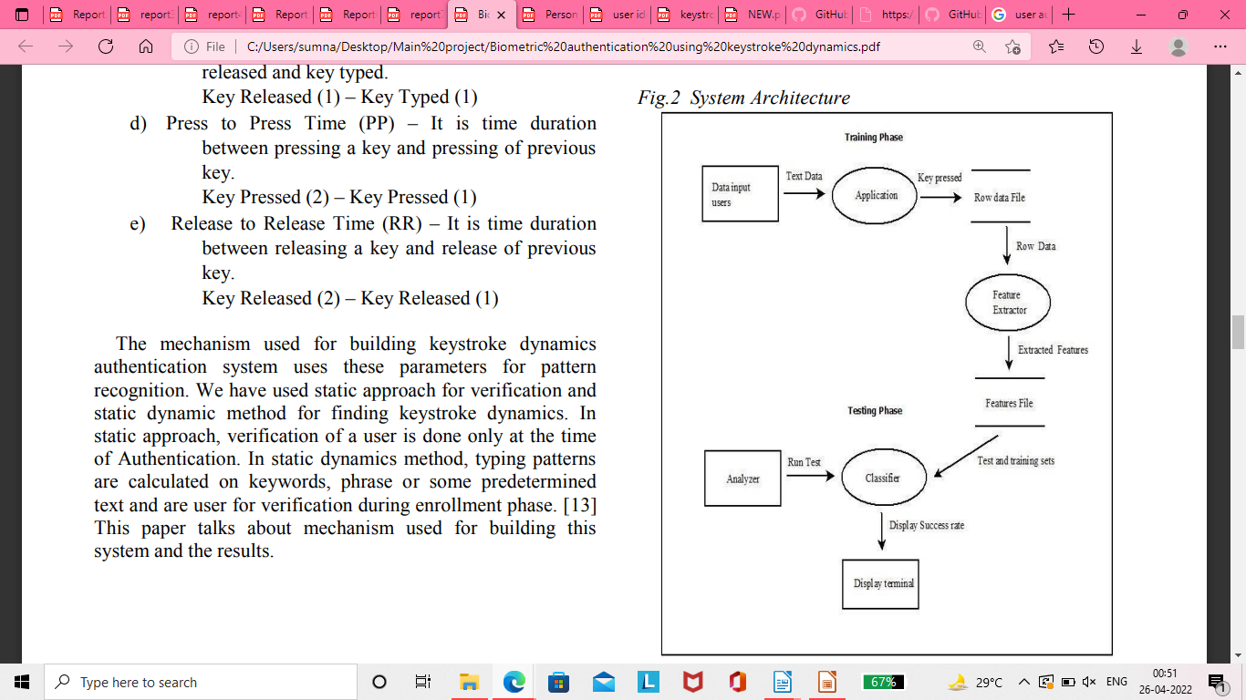
PROJECT PIPELINE:

Slide 14
DATASET
The dataset is obtained during the time of registration. That is, at the time of registration, the user is asked to give a username and a password. In addition to this, the user is also given a specific sentence or phrase which the user is asked to type a specific number of times. In this way, we get the values for the dataset.
In the dataset, it is planned to include latency, hold time and characters per minute
The parameters are:
Flight time: the duration between pressing and releasing a key
Dwell time: the duration between pressing a key and pressing another key
Press to press time: the duration between releasing a key and pressing a key
Release to release time: durations of pressing and releasing of enter key and space key
hold time of keys

Slide 15
Basic description about dataset
The database contain two tables, user table and login table. The details collected are name, age, mail id, phone number, username and feature. The feature is the keystroke values obtained

Slide 16

THANK YOU

